Slide 1
The Path to Predictive Coding in E-Discovery Search
The Future of Automation, Apps, & Data in Law
MIT
Cambridge, MA
November 26, 2015
Jason R. Baron, Esq.
Information Governance and eDiscovery Group
Drinker Biddle & Reath LLP
Washington, D.C. 20005
© Jason R. Baron 2017

Slide 2


In the course of my career, lawyers have gone from this….
To this new reality….

Slide 3

Living in an exponential world

Slide 4
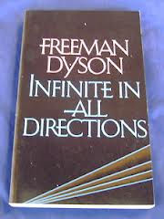

We have entered the era where Big Data is ….

Slide 5

Reality: The era of information inflation and Big Data in litigation has just begun….
Lehman Brothers Investigation
350 billion page universe (3 petabytes)
Examiner narrowed collection by selecting key custodians, using dozens of Boolean searches
Reviewed 5 million docs (40 million pages using 70 contract attorneys)
Source: Report of Anton R. Valukas, Examiner, In re Lehman Brothers Holdings Inc., et al., Chapter 11 Case No. 08-13555 (U.S. Bankruptcy Ct. S.D.N.Y. March 11, 2010), Vol. 7, Appx. 5, at http://lehmanreport.jenner.com/.

Slide 6

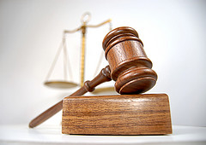
E-Discovery: The New Reality

Slide 7
A New Legal Term of Art Under the Federal Rules of Civil Procedure: Electronically Stored Information or “ESI”
“Electronically stored information”:
The wide variety of computer systems currently in use, and the rapidity of technological change, counsel against a limiting or precise definition of ESI…A common example [is] email … The rule … [is intended] to encompass future developments in computer technology.
--Advisory Committee Notes to Rule 34(a), 2006 Amendments

Slide 8
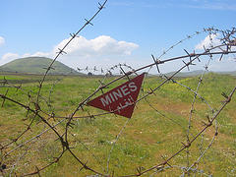
The Litigation Minefield
U.S. litigation increasingly demands the preservation of and access to all relevant documents, including in the form of “electronically stored information” or “ESI”
Courts impose sanctions on parties for failing to preserve evidence under the “spoliation” doctrine
Absent saving everything, often it is only with 20/20 hindsight that one can determine what should have been preserved in response to a lawsuit
Courts are increasingly expecting that reasonable searches be performed against ESI using automated methods (not manual searching)

Slide 9
Overarching Questions
How do lawyers approach the “search” task in e-discovery?
(And how is it different than the problem of finding a good restaurant tonite in Boston,via the web?)
What constitutes the “state of the art” in e-discovery search?
What form of benchmarking or standard-setting effort might be even possible to accomplish in the area of legal e-discovery?

Slide 10
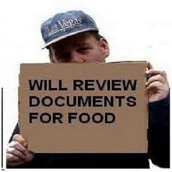
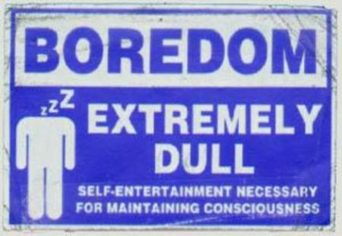
Traditional Document Review Processes
Labor intensive
Linear Review
Quality of manual coding for responsiveness open to question (see RAND Study, 2012)

Slide 11
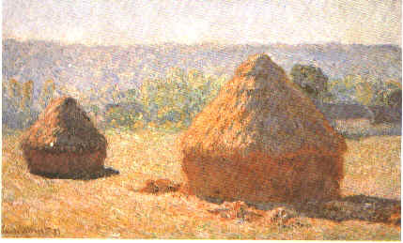
An information retrieval task: searching the Haystack….

Slide 12
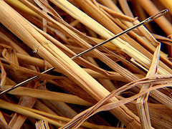
to find relevant needles…

Slide 13

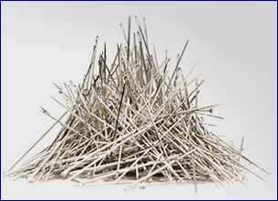
And they would like to find JUST the wheat, not the chaff (100% precision)
But not just one or a few needles…
Lawyers need to find ALL the relevant needles (100% recall)

Slide 14

Email is still the 800 lb. gorilla of ediscovery

Slide 15
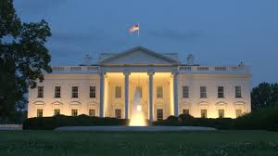
Presidential E-mail

Slide 16
Case example: U.S. v. Philip Morris et al.
Civil lawsuit brought by Clinton Administration against tobacco companies in 1999
Racketeering allegation that companies have conspired since 1953 to defraud the American public as to the true health effects of smoking
1,726 Requests to Produce from tobacco companies for tobacco-related records (including email) from 30 federal agencies
32 million Clinton-era email records held by National Archives

Slide 17
Case Study: U.S. v. Philip Morris (con’t) – Employing a limited feedback loop
Original set of 12 keywords searched unilaterally
After informal negotiations, additional terms explored
Sampling against database to find “noisy” terms generating too many false positives (Marlboro, PMI, TI, etc.)
Report back and consensus on what additional terms would be in search protocol.

Slide 18
Query Terms
Round 1
Round 2
tobacco
cigarette
smoking
<tar>
nicotine
Smokeless
Synar Amendment
Philip Morris
R.J. Reynolds
BAT Industries
Liggett group
Brown and Williamson
Liggett
PMI
(Philip Morris Institute)
MSA
(Master Settlement Agreement)
ETS
(Environmental Tobacco Smoke)
B&W
(Brown & Williamson)
TI (Tobacco Institute)
…

Slide 19


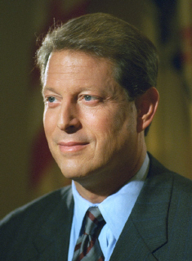
White House Counsel
False
Positives
Relevant
Smoking Policy Emails
VP Chief of Staff
Ron Klain
Office of the U.S. Trade Rep.
OMB

Slide 20
Suppressing False Positives
Marlboro vs. Upper Marlboro, Maryland
Philip Morris Institute vs. Presidential Management Intern (PMI) program
Master Settlement Agreement vs. Medical Savings Accounts and Metropolitan Standard Areas
Tobacco Institute (TI) vs. do re me….

Slide 21

Example of Boolean search string from U.S. v. Philip Morris
(((master settlement agreement OR msa) AND NOT (medical savings account OR metropolitan standard area)) OR s. 1415 OR (ets AND NOT educational testing service) OR (liggett AND NOT sharon a. liggett) OR atco OR lorillard OR (pmi AND NOT presidential management intern) OR pm usa OR rjr OR (b&w AND NOT photo*) OR phillip morris OR batco OR ftc test method OR star scientific OR vector group OR joe camel OR (marlboro AND NOT upper marlboro)) AND NOT (tobacco* OR cigarette* OR smoking OR tar OR nicotine OR smokeless OR synar amendment OR philip morris OR r.j. reynolds OR ("brown and williamson") OR ("brown & williamson") OR bat industries OR liggett group)

Slide 22
U.S. v. Philip Morris E-mail Winnowing Process
20 million → 200,000 → 100,000 → 80,000 → 20,000
email hits based relevant produced placed on
records on keyword emails to opposing privilege
terms used party logs
(1%)
→ A PROBLEM: only a handful entered as exhibits at trial
→ A BIGGER PROGLEM: the 1% figure does not scale

Slide 23
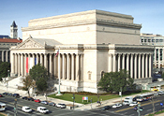
Clinton White House
search request
Tobacco Policy
20 million emails
~~~~~~~~~~~~~~~~~~~~~~~~~~~~~~~~~~~~~~~~
~~~~~~~~~~~~~~~~~~~~~~~~~~~~~~~~~~~~~~~~
100,000 relevant docs, with 20,000 privileged
National Archives
hired 25 persons
for 6 months …
~~~~~~~~~~~~~~~~~~~~~~~~~~~~~~~~~~~~~~~~
200,000 docs with “hits”
Notes:
There are problems in the real world that involve searching thru millions to return tens of thousands of results and we have to better tools to do that than we have now.
Millions and we have to produce tens of thiusands and we have to have better tools because we cannot afford to hire 25 for 6 months.
There is a collection of 32 million emails deposited to National Archives of US by Clinton (administration /) White house. That’s only from presidential records and federal records from the executive office of the president. But of course the entire rest of the government will in the future be making similar deposits. So this 32 m emails is Larger collection than NA is able to handle/review but is not nearly as large as what they have to be able to handle in the future.
Since this collection is not public yet, NARA got a legal request asking for emails that talk about tobacco. In response, NARA
They got a request (because it’s not yet public) that went to the archivists that have them doing searches for a law suit about tobacco settlement / so they wanted to find things talking about tobacco policy in this 32 m emails. Hired 50 lawyers worked for 6 months they reviewed 200 thousand emails (which is less than 1% of the collection size) of which 80 thousands were released to the people requesting. We cannot continue to do this. We must have more effective techniques for this kind of problem.
So, it is clear that searching or making sense of such large scale of collection needs new set of tools that can help in that situation.
poses challenges
Using boolean
NOT SCALABLE
------------------
-------
Imagine u have a large collection of email (millions of emails) and u want to make an exploratory search / make sense of this collection. If u were not actually participating in such informal form of communication, u would have very hard time understanding/recognizing (it would be very hard to realize) who is talking to whom and about who. For example, NA has 32 million emails from Clinton and expecting more than 150 millions from the current admin. Such large scale of collection needs new set of tools that can help in that situation.
In this work we explore one of the capabilities that such tools will need: computational model of identity.

Slide 24
Clinton White House
search request
Tobacco Policy
20 million emails
~~~~~~~~~~~~~~~~~~~~~~~~~~~~~~~~~~~~~~~~
~~~~~~~~~~~~~~~~~~~~~~~~~~~~~~~~~~~~~~~~
100,000 relevant docs, with 20,000 privileged
National Archives
hired 25 persons
NOTE: No one sampled the 19,800,00 docs that weren’t “hit” by a keyword
for 6 months …
~~~~~~~~~~~~~~~~~~~~~~~~~~~~~~~~~~~~~~~~
200,000 docs with “hits”
Notes:
There are problems in the real world that involve searching thru millions to return tens of thousands of results and we have to better tools to do that than we have now.
Millions and we have to produce tens of thiusands and we have to have better tools because we cannot afford to hire 25 for 6 months.
There is a collection of 32 million emails deposited to National Archives of US by Clinton (administration /) White house. That’s only from presidential records and federal records from the executive office of the president. But of course the entire rest of the government will in the future be making similar deposits. So this 32 m emails is Larger collection than NA is able to handle/review but is not nearly as large as what they have to be able to handle in the future.
Since this collection is not public yet, NARA got a legal request asking for emails that talk about tobacco. In response, NARA
They got a request (because it’s not yet public) that went to the archivists that have them doing searches for a law suit about tobacco settlement / so they wanted to find things talking about tobacco policy in this 32 m emails. Hired 50 lawyers worked for 6 months they reviewed 200 thousand emails (which is less than 1% of the collection size) of which 80 thousands were released to the people requesting. We cannot continue to do this. We must have more effective techniques for this kind of problem.
So, it is clear that searching or making sense of such large scale of collection needs new set of tools that can help in that situation.
poses challenges
Using boolean
NOT SCALABLE
------------------
-------
Imagine u have a large collection of email (millions of emails) and u want to make an exploratory search / make sense of this collection. If u were not actually participating in such informal form of communication, u would have very hard time understanding/recognizing (it would be very hard to realize) who is talking to whom and about who. For example, NA has 32 million emails from Clinton and expecting more than 150 millions from the current admin. Such large scale of collection needs new set of tools that can help in that situation.
In this work we explore one of the capabilities that such tools will need: computational model of identity.

Slide 25
Growth in Presidential and Federal Records in Electronic Form
William Clinton White House 32 million emails (presidential and federal records)
George W. Bush White House 200+ million emails
Barack Obama White House ~ 300+ million emails expected by Jan. 2017 + records on social media
And after 2019: billions of emails and all forms of electronic records from hundreds of Executive Branch agencies being accessioned into the National Archives
HOW MANY OF THESE RECORDS WILL BE ACCESSIBLE TO THE PUBLIC AND HOW SOON?

Slide 26
A Hypothetical
1 billion emails, 25% with attachments
Reviewed at 50 per hour
Would take 100 people, 10 hrs per day, 7 days a week, 52 weeks a year ….
54 YEARS TO COMPLETE
At $100/hr, $ 2 billion in cost
Even 1% (10 million docs) … 28 weeks
and $20 million in cost …..

Slide 27

Tomorrow’s Vaster Collections

Slide 28
Myth, Hype, Reality
+ Human review as the ‘gold standard’
+ Vendor claims
+ Past research (Blair & Maron, 1985) has shown a gap or disconnect between lawyers’ perceptions of their ability to ferret out relevant documents, and their actual ability to do so:
--in a 40,000 document case (350,000 pages), lawyers estimated that a manual search would find 75% of relevant documents, when in fact the research showed only 20% or so had been found.

Slide 29
More Reality: IR is Hard
+ Information retrieval (IR) is a hard problem: difficult even with English-language text, and even harder with non-textual forms of ESI (audio, video, etc.) caught up in litigation.
+ A vast field of IR research exists, including some fundamental concepts and terminology, that lawyers would benefit from having greater exposure with.

Slide 30
IR is Hard Due to Inherent Ambiguity of Language
Synonymy: variation in describing same person or thing in multiplicity of ways (e.g., “diplomat,” “consul,” “official,” ambassador,” etc.)
Polysemy: ambiguous terms (e.g., “George Bush,” “strike,”)

Slide 31
Why is IR hard (cont.)
+ Ubiquity of human error (misspellings, typos)
+ Abbreviations & colloquialisms; corporate
slang, new short forms used in text
and instant messaging
+ OCR issues
+ Poor records management
+ The reality is that huge sources of heterogeneous ESI exist, presenting an array of technical issues
+ Deadlines and resource constraints
+ Failure to employ best strategic practices

Slide 32
Judge Grimm writing for the U.S. District Court for the District of Maryland
“[W]hile it is universally acknowledged that keyword searches are useful tools for search and retrieval of ESI, all keyword searches are not created equal; and there is a growing body of literature that highlights the risks associated with conducting an unreliable or inadequate keyword search or relying on such searches for privilege review.” Victor Stanley, Inc. v. Creative Pipe, Inc., 250 F.R.D. 251 (D. Md. 2008); see id., text accompanying nn. 9 & 10 (citing to Sedona Search Commentary & TREC Legal Track research project)

Slide 33
Judge Facciola writing for the U.S. District Court for the District of Columbia
“Whether search terms or ‘keywords’ will yield the information sought is a complicated question involving the interplay, at least, of the sciences of computer technology, statistics and linguistics. See George L. Paul & Jason R. Baron, Information Inflation: Can the Legal System Adapt?', 13 RICH. J.L. & TECH.. 10 (2007) * * * Given this complexity, for lawyers and judges to dare opine that a certain search term or terms would be more likely to produce information than the terms that were used is truly to go where angels fear to tread.”
-- U.S. v. O'Keefe, 537 F.Supp.2d 14, 24 D.D.C. 2008).

Slide 34
Judge Peck writing for the U.S. District Court for the Southern District of New York
William A. Gross Construction Associates Inc. v. American Manufacturers Mutual Ins. Co., 2009 WL 724954 (S.D.N.Y. March 19, 2009) (in multi-million dollar dispute, where issue involved production of 3rd party emails where none of the three parties could agree on keyword search terms, court fashioned a compromise; court stated at the outset that “this Opinion should serve as a wake-up call to the Bar … about the need for careful thought, quality control, testing and cooperation with opposing counsel in designing search terms or ‘keywords’ to be used.”)

Slide 35
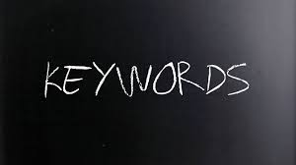
A flawed, inefficient approach to searching ESI…..

Slide 36

In Search of A Better Way for Lawyers To Search ESI

Slide 37

Questions
How can we efficiently reduce volumes of data to cull through for purposes of search and review?
How can one go about improving rates of recall and precision (so as to find a greater number of relevant documents, while spending less overall time, cost, etc., sifting through noise?)
What alternatives to keyword searching exist?
Are there ways in which to benchmark alternative search methodologies so as to evaluate their efficacy?

Slide 38
FINDING RESPONSIVE DOCUMENTS IN A LARGE DATA SET: FOUR LOGICAL CATEGORIES
Relevant and Retrieved
Not Relevant and Retrieved
DOCUMENT SET
FALSE POSITIVES
Relevant and Not Retrieved
Not Relevant and Not Retrieved
FALSE NEGATIVES

Slide 39
Recall & Precision

Slide 40
Recall & Precision
Team A
Recall = 30.5%
Precision = 7.7%
F1 = 12.3%

Slide 41
Recall & Precision
Team B
Recall = 19.8%
Precision = 16.9%
F1 = 18.3%

Slide 42
Recall & Precision
Team C
Recall = 76.2%
Precision = 84.4%
F1 = 80.1%

Slide 43
What is TREC?
Conference series co-sponsored by the National Institute of Standards and Technology (NIST) and the Advanced Research and Development Activity (ARDA) of the Department of Defense
Designed to promote research into the science of information retrieval
First TREC conference was in 1992
15th Conference held November 15-17, 2006 in U.S. in Gaithersburg, Maryland (NIST headquarters)

Slide 44
TREC Legal Track
The TREC Legal Track was designed to evaluate the effectiveness of search technologies in a real-world legal context
First of a kind study using nonproprietary data since Blair/Maron research in 1985
Hypothetical complaints and 100+ “requests to produce” drafted by members of The Sedona Conference®
“Boolean negotiations” conducted as a baseline for search efforts
Documents to be searched were drawn from a publicly available 7 million document tobacco litigation Master Settlement Agreement database
New Interactive Task added in 2008 and continued in 2009 using Topic Authorities and a post-adjudication round
In 2009, a second Enron data set was added as a separate task
Participating teams of information scientists from around the world contributing computer runs, plus in 2008 and 2009 from legal service providers
Results from 2009 round with 11 participants in interactive task currently being processed – will be posted on TREC website soon

Slide 45
TREC Legal Track: Example of Prior Year Ad Hoc Topic
RequestNumber: 52
RequestText: Please produce any and all documents that discuss the use
or introduction of high-phosphate fertilizers (HPF) for the
specific purpose of boosting crop yield in commercial
agriculture.
Proposal: "high-phosphate fertilizer!" AND (boost! w/5 "crop yield")
AND (commercial w/5 agricultur!)
Rejoinder: (phosphat! OR hpf OR phosphorus OR fertiliz!)
AND (yield! OR output OR produc! OR crop OR crops)
FinalQuery: (("high-phosphat! fertiliz!" OR hpf) OR
((phosphat! OR phosphorus) w/15 (fertiliz! OR soil))) AND
(boost! OR increas! OR rais! OR augment! OR affect! OR
effect! OR multipl! OR doubl! OR tripl! OR high! OR greater)
AND (yield! OR output OR produc! OR crop OR crops)
B: 3078

Slide 46

Beyond Boolean: getting at the “dark matter” (i.e., relevant documents not found by keyword searches alone)

Slide 47
Nobody Finds Everything
Source: TREC 2006 Legal Track

Slide 48
“Boolean” Searches May Miss A Large Percentage of Relevant Documents
78% of relevant documents were only found by some other technique
Source: TREC 2007 Legal Track

Slide 49
Boolean v. TREC Systems: Results of Legal Track Years 1 and 2
Notes:
49

Slide 50
TREC 2009 Legal Track -Interactive TaskTopics
Topic 201. All documents or communications that describe, discuss, refer to, report on, or relate to the Company’s engagement in structured commodity transactions known as “prepay transactions.”
Topic 202. All documents or communications that describe, discuss, refer to, report on, or relate to the Company’s engagement in transactions that the Company characterized as compliant with FAS 140 (or its predecessor FAS 125).
Topic 203. All documents or communications that describe, discuss, refer to, report on, or relate to whether the Company had met, or could, would, or might meet its financial forecasts, models, projections, or plans at any time after January 1, 1999.
Topic 204. All documents or communications that describe, discuss, refer to, report on, or relate to any intentions, plans, efforts, or activities involving the alteration, destruction, retention, lack of retention, deletion, or shredding of documents or other evidemce, whether in hard-copy of electronic form.
Topic 205. All documents or communications that describe, discuss, refer to, report on, or relate to energy schedules and bids, including but not limited to, estimates, forecasts, descriptions, characterizations, analyses, evaluations, projections, plans, and reports on the volume(s) or geographic location(s) of energy loads.

Slide 51
TREC 2009 Legal Track -Interactive TaskTopics (con’t)
Topic 206. All documents or communications that describe, discuss, refer to, or relate to any discussion(s), communication(s), or contact(s) with financial analyst(s), or with the firm(s) that employ them, regarding (i) the Company’s financial condition, (ii) analysts’ coverage of the Company and/or its financial condition, (iii) analysts’ rating of the Company’s stock, or (iv) the impact of an analyst’s coverage of the Company on the business relationship between the Company and the firm that employs the analyst.
Topic 207. All documents or communications that describe, discuss, refer to, report on, or relate to fantasy football, gambling on football, and related activities, including but not limited to, football teams, football players, football games, football statistics, and football performance.

Slide 52
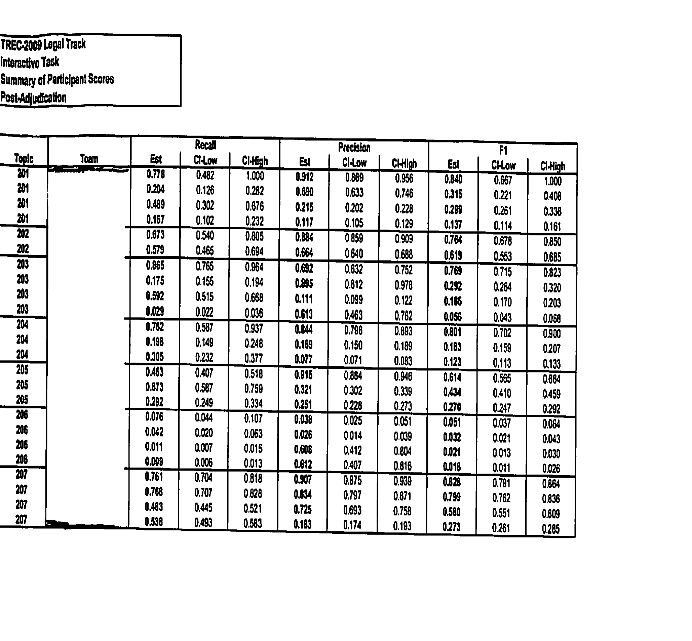
Results from TREC 2009 Legal Interactive Task

Slide 53
Interactive Task – Results from 2008 & 2009
Topic 102 (2008)
Topic 103 (2008)
Topic 104 (2008)
Topic 201 (2009)
Topic 202 (2009)
Topic 203 (2009)
Topic 204 (2009)
Topic 205 (2009)
Topic 206 (2009)
Topic 207 (2009)

Slide 54
Team-Topic Authority (TA Interaction and Effectiveness

Slide 55
Rate of Appeals and Improvement in Scores

Slide 56
Improving Search Effectiveness Through Relevance Feedback and Multple Meet and Confers
Second Meet and Confer
1st Meet and Confer
Source: F.C. Zhao, D. W. Oard, and J.R. Baron, “Improving Search Effectiveness in the Legal E-Discovery Process Using Relevance Feedback” (2009)

Slide 57
Findings from the TREC Legal Track
Beating Boolean is hard work (one on one)
And yet we know substantial dark matter in the form of the true R (i.e., # of relevant docs) in large corporate repositories exists, not found by traditional keyword searching alone
2009 results especially show substantial gains in terms of recall and precision when process allows for human in the loop to assist training systems (interaction with topic authority experts)

Slide 58
Beyond Keywords: Alternative Search Methods
Greater Use Made of Boolean Strings
Fuzzy Search Models
Probabilistic models (Bayesian)
Statistical methods (clustering)
Machine learning approaches to semantic representation
Categorization tools: taxonomies and ontologies
Social network analysis
Hybrid approaches
Reference: Appendix to The Sedona Conference® Best Practices Commentary on the Use of Search and Information Retrieval Methods in E-Discovery (2007), available at http://www.thesedonaconference.org (link to publications)

Slide 59
E-discovery Strategies: “Predictive Coding”
Improving review thru use of software with minimal human intervention – relying on software to generate clusters of related documents, and training the software thru multiple iterations to find responsive records

Slide 60
Defining “predictive coding” or “TAR”
A process for prioritizing or coding a collection of electronic documents using a computerized system that harnesses human judgments of one or more subject matter experts on a smaller set of documents and then extrapolates those judgments to the remaining document population.
Also referred to as “supervised or active machine learning,” “computer-assisted review” or “technology-assisted review”
Source: Adapted from Grossman-Cormack Glossary of Technology Assisted Review, v. 1.0 (Oct 2012)

Slide 61
Vector Space Model
documents represented as vectors in N-dimensional space where N is number of ‘terms’ in the document set
term is usually a word (stem); but might be phrase or thesaurus class
terms are weighted based on frequency and distribution of occurrences
information need is natural language text mapped in same space
matching is similarity between query and doc vectors
example similarity: cosine of angle between vectors
allows documents to be ranked by decreasing similarity
Pros and Cons
good: less brittle than pure Boolean
bad: less transparency---depending on weights, a doc with few query terms can be ranked higher than a doc with many
From Ellen Voorhees, Georgetown 2009

Slide 62
Vector Similarities
Document-Document similarity
docs are similar to the extent they contain the same terms
doc pairs with maximal similarity detects duplicates
document clustering
cluster hypothesis: “Closely associated documents tend to be relevant to the same requests.”
thus, do retrieval based on returning whole clusters since usually much more information in doc-doc comparison than doc-query
Term-Term similarity
terms are similar to the extent the occur in the same documents
term clustering
query expansion
provide bottom-up description of document set
From Ellen Voorhees, Georgetown 2009
T1 T2 T3 T4 …
D1
D2
D3
D4
D5
D6…
5 0 33 0 …
0 0 8 0 …
1 4 0 2 …
0 3 0 4 …
0 1 0 0 …
3 2 0 …

Slide 63
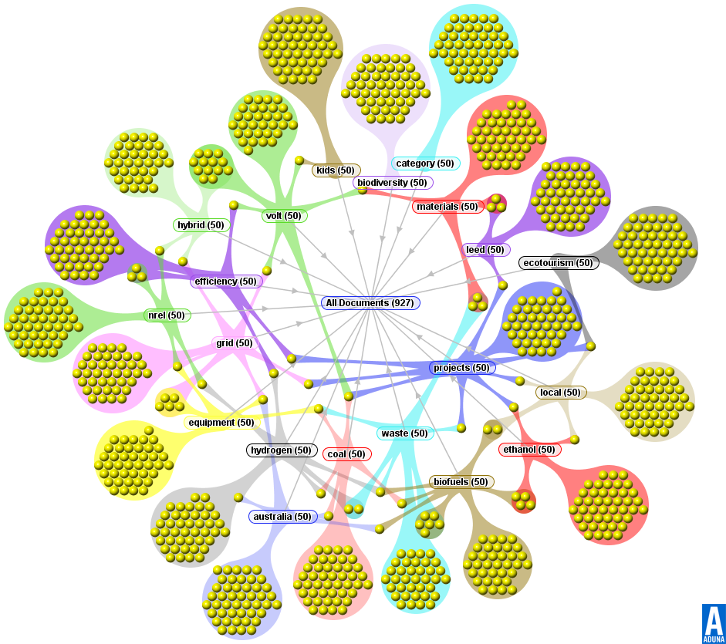
Social Networks & Visual Analytics

Slide 64
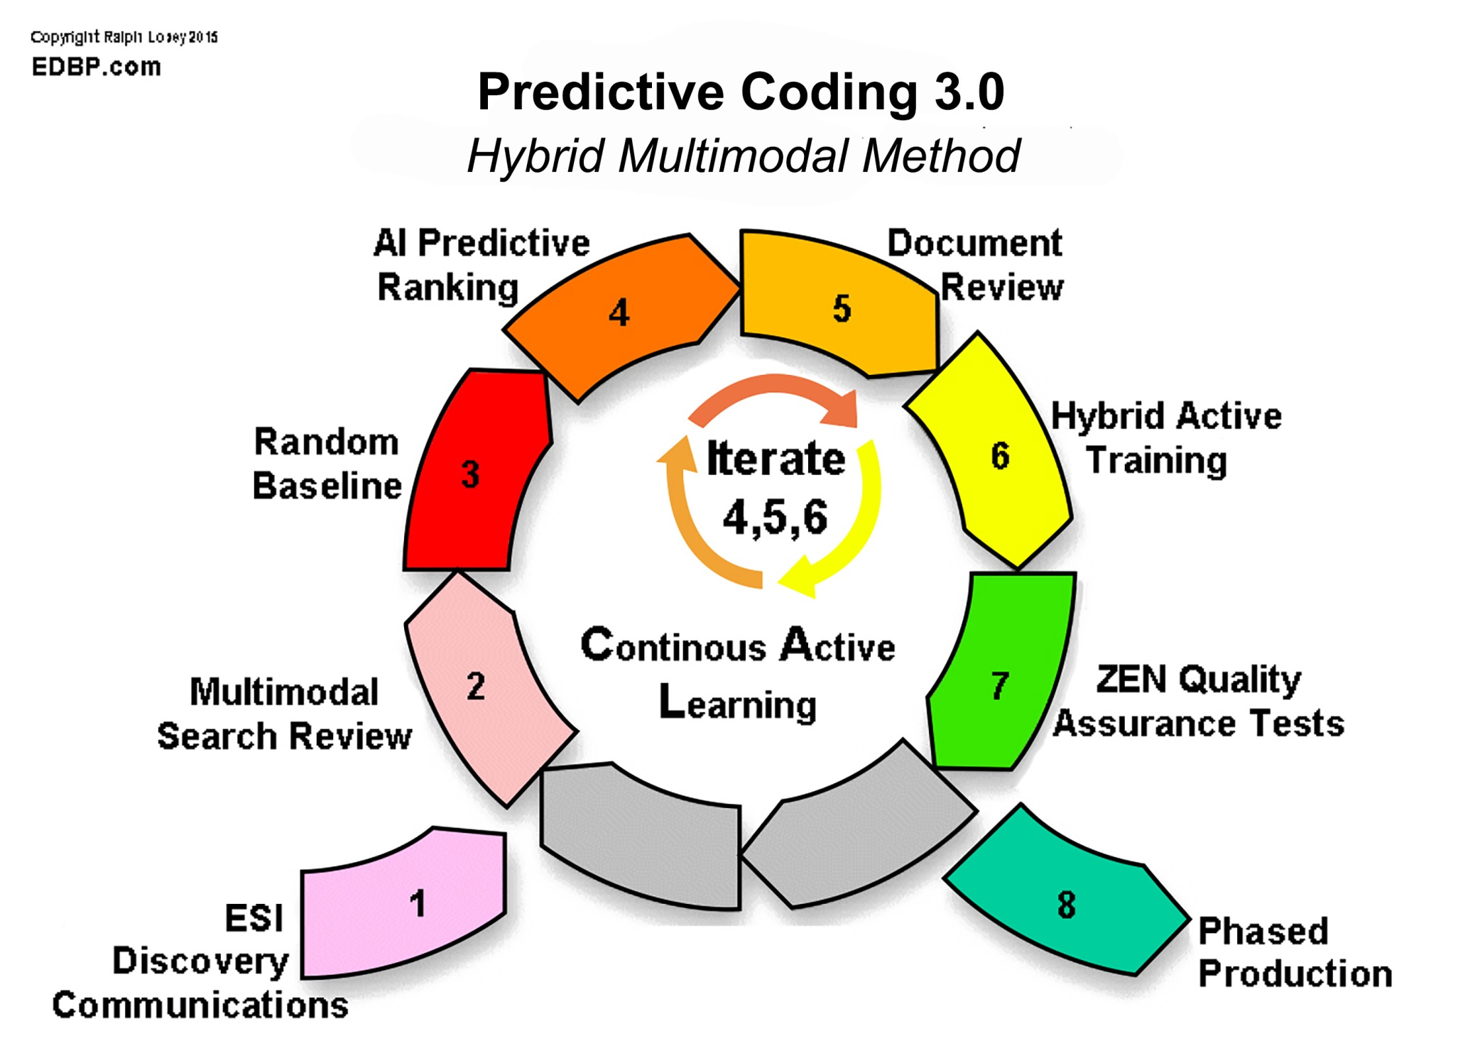

Slide 65
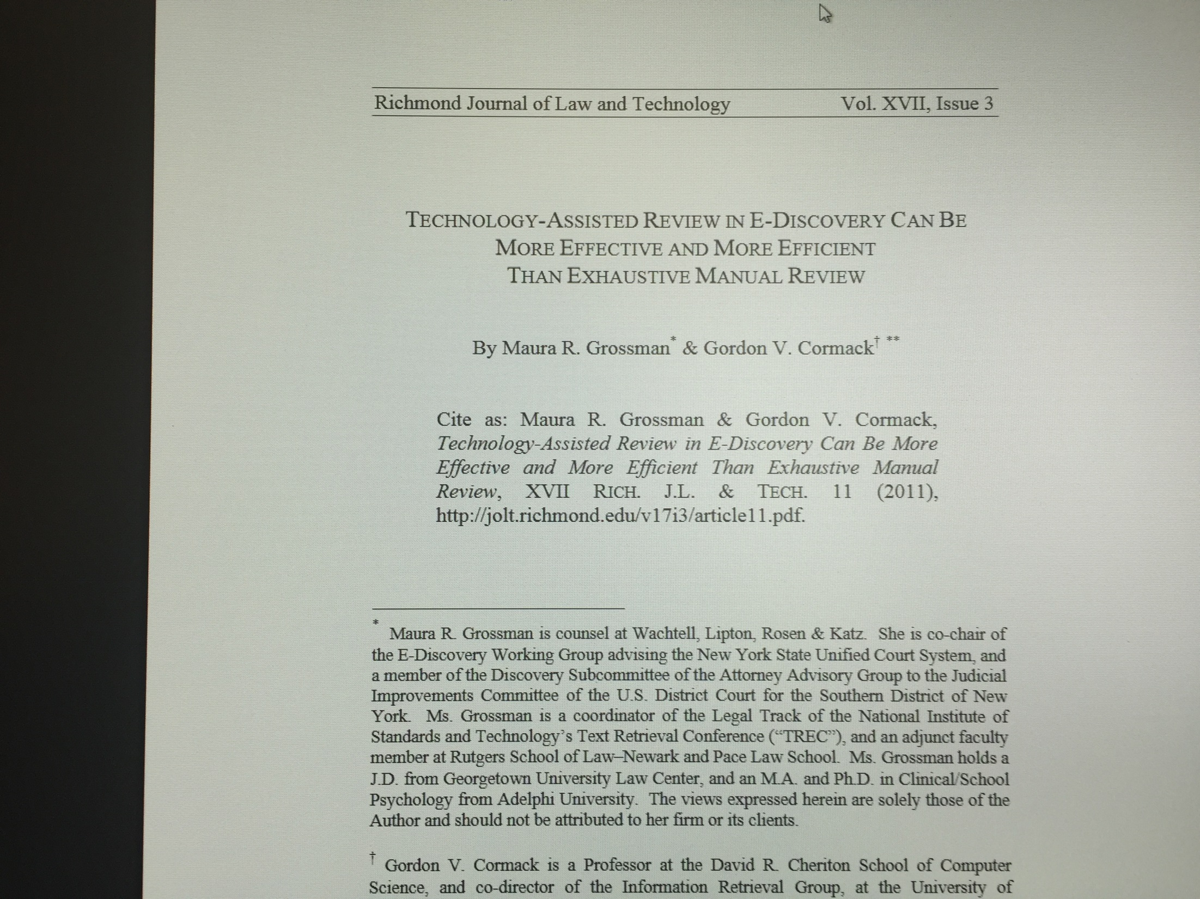

Slide 66
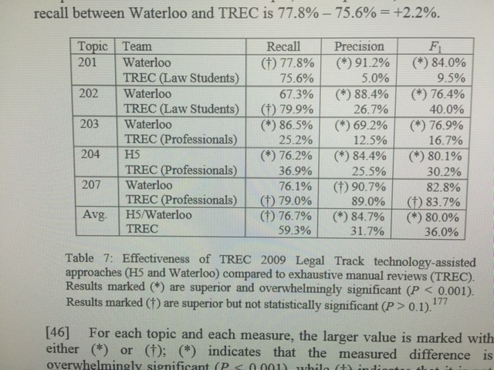

Slide 67
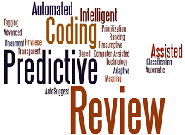
I

Slide 68
Judicial endorsement of predictive analytics in document review by Judge Peck in da Silva Moore v. Publicis Groupe (SDNY Feb. 24, 2012)
This opinion appears to be the first in which a Court has approved of the use of computer-assisted review. . . . What the Bar should take away from this Opinion is that computer-assisted review is an available tool and should be seriously considered for use in large-data-volume cases where it may save the producing party (or both parties) significant amounts of legal fees in document review. Counsel no longer have to worry about being the ‘first’ or ‘guinea pig’ for judicial acceptance of computer-assisted review . . . Computer-assisted review can now be considered judicially-approved for use in appropriate cases.

Slide 69
Da Silva Moore vs. Publicis Groupe & MSL Group, 287 F.R.D. 182 (S.D. N.Y. 2012) (Peck, Magistrate Judge)
“This Opinion appears to be the first in which a Court has approved of the use of computer-assisted review. That does not mean computer-assisted review must be used in all cases, or that the exact ESI protocol approved here will be appropriate in all future cases that utilize computer-assisted review. . . . What the Bar should take away from this Opinion is that computer-assisted review is an available tool and should be seriously considered for use in large-data-volume cases where it may save the producing party (or both parties) significant amounts of legal fees in document review. Counsel no longer have to worry about being the “first” or “guinea pig” for judicial acceptance of computer-assisted review. . . . Computer-assisted review now can be considered judicially-approved for use in appropriate cases.

Slide 70
The da Silva Moore Protocol
Supervised learning
Random sampling
Establishment of seed set
Issue tags
Iteration
Random sampling of docs deemed irrelevant

Slide 71
Two approaches to selecting the seed set
Random selection: documents selected at random from the collection, coded as relevant or not, and fed to the learning system
Problem: may miss certain types of relevant docs that
are rare in the collection and therefore
unrepresented in a random sample
Judgmental selection: documents are selected by an expert, using prior knowledge, or ad hoc searches, or other advanced tools, and then fed to the learning system
Problem: may miss certain types of relevant documents
that are overlooked by the expert, or not
identified by the search and analytic tools
Source: M. Grossman ABA Slideset 2012

Slide 72
Two Important Open Questions as of 2011 When the Legal Track ended
Should lawyers use “seed sets” for training?
Should lawyers rely on random sampling for the seed set vs. using known relevant documents (some of which may be privileged)

Slide 73
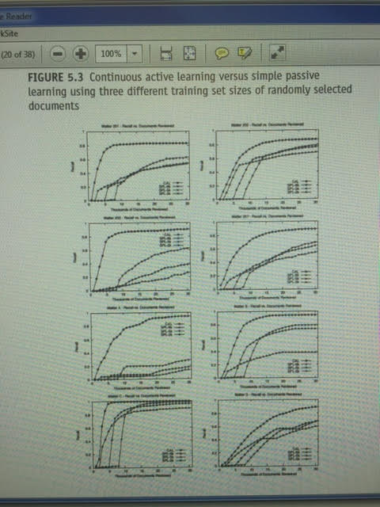
G.V. Cormack & M.R. Grossman, Evaluation of Machine-Learning Protocols for Technology-Assisted Review in Electronic Discovery, SIGIR ’14, July 2014 (Gold Coast, Queensland, Australia)

Slide 74



Faith in Analytics

Slide 75

Black boxes

Slide 76
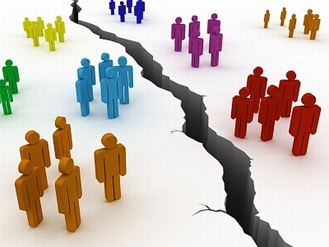
To Advance the Cause, Lawyers Should Be Working With Computer ScientistsTo Further Develop Advanced Search Tools For the Future

Slide 77
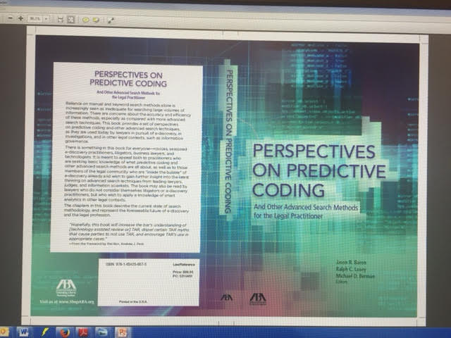

Slide 78
References
Sources for Advanced Search Methods in E-Discovery
J.R.Baron, R.C. Losey, M.D. Berman, eds., Perspectives in Predictive Coding and Other Advanced Searth Methods in E-Discovery (ABA 2016)
B. Borden & J.R. Baron, “Finding the Signal in the Noise: Information Governance, Analytics, and The Future of the Law,” 20 Richmond J. Law & Technology (2014) (available online)
J.R. Baron, “Law in the Age of Exabytes: Some Further Thoughts on ‘Information Inflation’ and Current Issues in E-Discovery Search, 17 Richmond J. Law & Technology (2011), see http://law.richmond.edu
N. Pace, “Where The Money Goes: Understanding Litigant Expenditures for Producing E-Discovery,” RAND Publication (2012), see http://www.rand.org/pubs/monographs/MG1208.html
TREC Legal Track Home Page, http://trec-legal.umiacs.umd.edu (includes bibliography for further reading)
The Sedona Conference, Best Practices Commentary on The Use of Search & Retrieval Methods in E-Discovery, (2013), www.thesedonaconference.org
“Supervised Learning/Predictive Coding” Case Law:
Da Silva Moore v. Publicis Groupe, 2012 WL 607412 (S.D.N.Y. Feb. 24, 2012), approved and adopted in Da Silva Moore v. Publicis Groupe, 2012 WL 1446534, at *2 (S.D.N.Y. Apr. 26, 2012)
EORHB v HOA Holdings, Civ. No. 7409-VCL (Del. Ch. Oct. 15, 2012)
Global Aerospace Inc., et al. v. Landow Aviation, L.P., et al., 2012 WL 1431215 (Va. Cir. Ct. Apr. 23, 2012).
In re Actos (Pioglitazone) Products, 2012 WL 3899669 (W.D. La. July 27, 2012)
Kleen Products, LLC v. Packaging Corp. of America, 10 C 5711 (N.D. Ill.) (Nolan, M.J.)
In re Biomet M2a Magnum Hip Implant Products Liability Litigation, 3:12-MD-2391 (S.D. Ind.) (April 18, 2013)

Slide 79
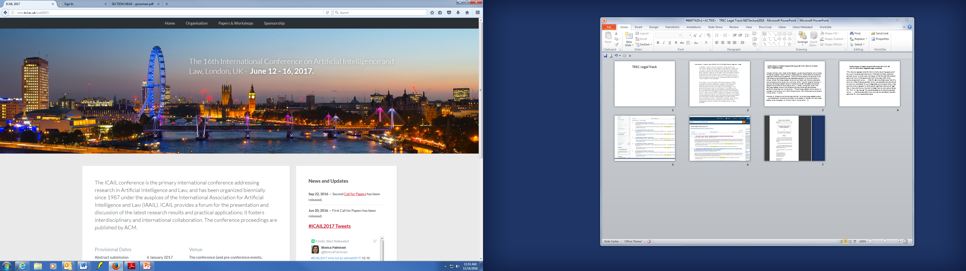

Slide 80

Jason R. Baron
Drinker Biddle & Reath
1500 K Street NW
Washington DC
(202) 230-5196
Email: jason.baron@dbr.com
twitter: @jasonrbaron1

